Slide 1
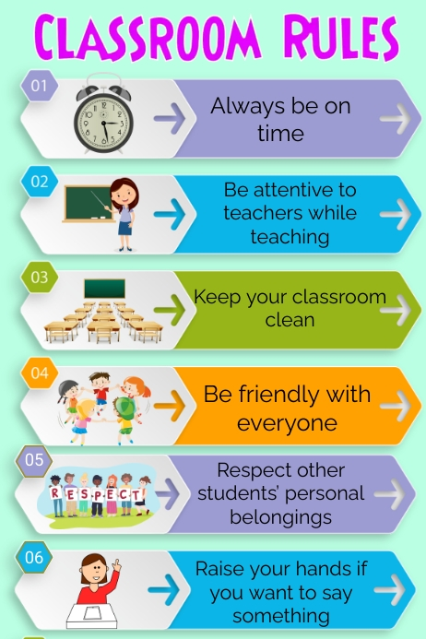
01
Everyone Deserve Respect both Students and Teachers
02
Kindly be on time
03
Raise Your hands for doubts.
Keep your mobile inside your bags in silent mode
06
Do homework and classwork properly.
07
Don’t eat food in lab or throw papers in lab or classroom..
08
Answer the questions if teacher asks you
Keep the place clean
04
09
Be Attentive in the class
Turn off the computer once your work completes.
05
10

Slide 2
UNIT 1 Fundamentals of Computing and introduction to Database systems

Slide 3

COMPUTER BASICS

Slide 4
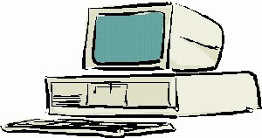
What is a Computer?
An electronic device that takes input and stores, retrieves, processes data, and produces output.
A computer is composed of hardware and software, and can exist in a variety of sizes and configurations.

Slide 5
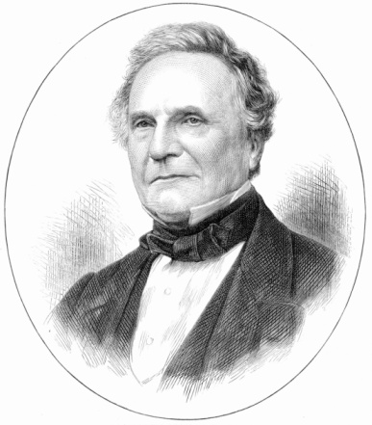
Who Invented the Computer?
Charles Babbage

Slide 6
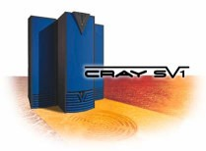
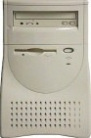
Types of Computers
Mini and Mainframe Computers
Very powerful, used by large organisations such an banks to control the entire business operation. Very expensive!
Personal Computers
Cheap and easy to use. Often used as stand-alone computers or in a network. May be connected to large mainframe computers within big companies.

Slide 7
CHARACTERISTICS OF COMPUTERS
The various characteristics of computers are as follows
Speed: Speed is the most important characteristics of computer .Computer having more speed to perform jobs instantaneously.
2. Accuracy: The computers are perfect, accurate and precise. Accuracy signifies the reliability of the hardware components of computers.
3. Automatic: A computer works automatically, once programs are stored and data are given to it, constant supervision is not required.
4. Endurance: A computer works continuously and will not get tired and will not suffer from lack of concentration.
5. Reduction of cost: Though initial investment may be high, computer substantially reduces the cost of transaction.

Slide 8
BASIC COMPUTER ORGANIZATION OR HARDWARE COMPONENTS:
A standard fully featured desktop configuration has basically four types of featured devices or handware components
1. Input Devices
2. Output Devices
3. Memory
4. Storage Devices

Slide 9
The Four Main Functions of Computers:-
A computer is designed for:
Data entry(Initial function i.e input device)
Data processing(CPU)
Information output(viewed via display monitor)
Data and information storage(hard disk drive)

Slide 10
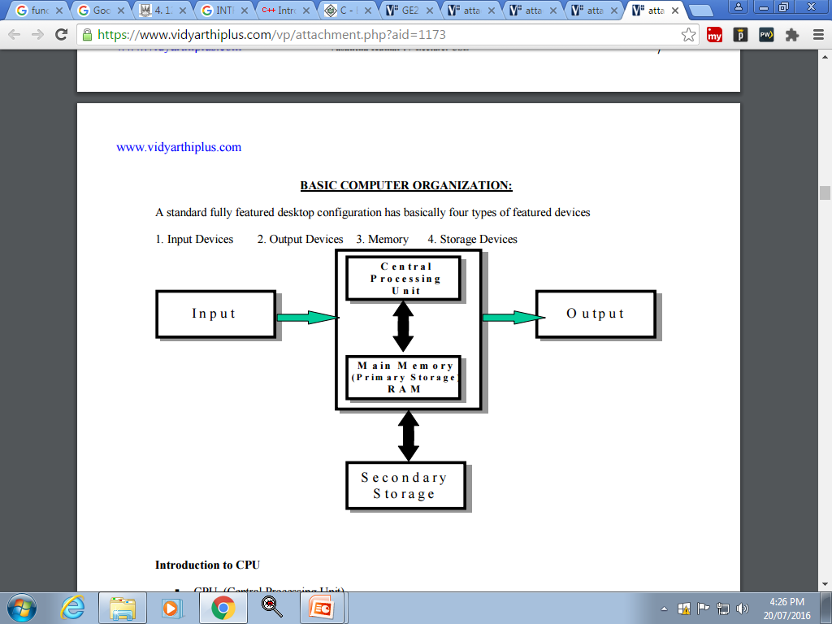

Slide 11
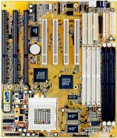
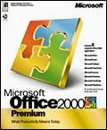
Hardware & Software
The term hardware refers to the physical components of your computer such as the system unit, mouse, keyboard, monitor etc.
The software is the instructions that makes the computer work.

Slide 12
Hardware Components
Input Devices -- "How to tell it what to do“
A keyboard and mouse are the standard way to interact with the computer. Other devices include joysticks and game pads used primarily for games.
Output Devices -- "How it shows you what it is doing"
The monitor (the screen) is how the computer sends information back to you. A printer is also an output device.

Slide 13
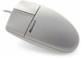
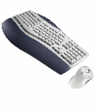
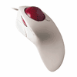
Hardware Components
INPUT DEVICES
The Mouse
Used to ‘drive’ Microsoft Windows
The Keyboard
The keyboard is still the commonest way of entering information into a computer
Tracker Balls
an alternative to the traditional mouse and often used by graphic designers

Slide 14
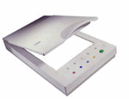
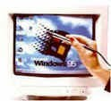
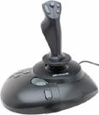
Hardware Components
INPUT DEVICES
Scanners
A scanner allows you to scan printed material and convert it into a file format that may be used within the PC
Light Pens
Used to allow users to point to areas on a screen
Joysticks
Many games require a joystick for the proper playing of the game

Slide 15
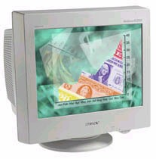
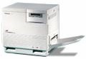
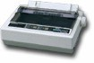
Hardware Components
OUTPUT DEVICES
VDU
The computer screen is used for outputting information in an understandable format
Printers
There are many different types of printers.
In large organizations laser printers are most commonly used due to the fact that they can print very fast and give a very high quality output.

Slide 16
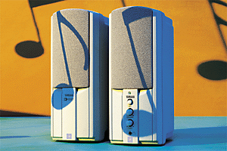
Hardware Components
OUTPUT DEVICES
Speakers
Enhances the value of educational and presentation products.

Slide 17
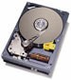

Hardware Components
Storage Devices -- "How it saves data and programs“
Hard disk drives are an internal, higher capacity drive which also stores the operating system which runs when you power on the computer.
"Floppy" disk drives allow you to save work on small disks and take the data with you.

Slide 18
Hardware Components
Hard Disks
Speed:
Very fast!
The speed of a hard disk is often quoted as "average access time" speed, measured in milliseconds. The smaller this number the faster the disk.
Capacity:
Often 40/80 Gigabytes.
A Gigabyte is equivalent to 1024 Megabytes.
Cost:
Hard disks costs are falling rapidly and normally represent the cheapest way of storing data.

Slide 19

Hardware Components
Diskettes (Floppy Disks)
Speed:
Very slow!
Capacity:
Normally 1.44 Mbytes.
Cost:
Very cheap.

Slide 20
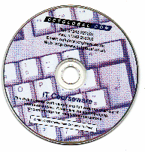
Hardware Components
CD-ROM Disks
Speed:
Much slower than hard disks.
Capacity:
Around 650 Mbytes and more

Slide 21
Hardware Components
DVD Drives
Speed:
Much faster than CD-ROM drives but not as fast as hard disks.
Capacity:
Up to 17 Gbytes.
Cost:
Slightly higher than CD-ROM drives.

Slide 22
Hardware Components
How Computer Memory Is Measured
Bit
All computers work on a binary numbering system, i.e. they process data in one's or zero's. This 1 or 0 level of storage is called a bit.
Byte
A byte consists of eight bits.
Kilobyte
A kilobyte (KB) consists of 1024 bytes.
Megabyte
A megabyte (MB) consists of 1024 kilobytes.
Gigabyte
A gigabyte (GB) consists of 1024 megabytes.

Slide 23

Hardware Components
Some of the Factors
That Impact on a Computer's Performance
CPU speed
RAM size
Hard disk speed and capacity

Slide 24
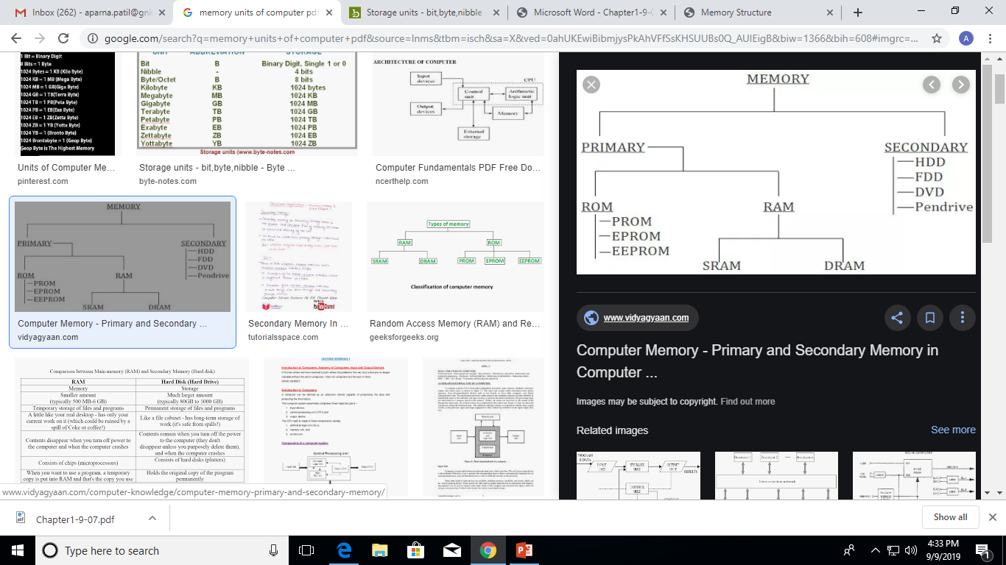

Slide 25
Primary Memory
Primary memory is also known as internal memory and main memory.
Primary storage comes as an integral part of all computer systems and includes all small locations to which unique numbers called and ADDRESS is assigned.
This is a section of the CPU which holds program instructions, input data and intermediate results.
Characteristic: Faster access time, less storage capacity and higher costs as compared to secondary storage units.
Storage capacity : few kilobytes on small computers to several thousand kilo bytes and megabytes on larger machines

Slide 26
CONT’D
Primary Memory:-
RAM: Random Access Memory (RAM) :
Is a memory scheme within the computer system responsible for storing data on a temporary basis, so that it can be promptly accessed by the processor as and when needed.
It is volatile in nature, which means that data will be erased once supply to the storage device is turned off.
RAM stores data randomly and the processor accesses these data randomly from the RAM storage.
RAM is considered "random access" because you can access any memory cell directly if you know the row and column that intersect at that cell.

Slide 27
TYPES OF RAM:
There are two types of RAM used in PCs –
Dynamic RAM (DRAM):
The information stored in Dynamic RAM has to be refreshed after every few milliseconds otherwise it will get erased.
DRAM has higher storage capacity and is cheaper than Static RAM.
Static RAM (SRAM):
The information stored in Static RAM need not be refreshed, but it remains stable as long as power supply is provided.
SRAM is costlier but has higher speed than DRAM.

Slide 28
CONT’D
2. ROM (Read Only Memory):
ROM is a permanent form of storage.
ROM stays active regardless of whether power supply to it is turned on or off.
ROM devices do not allow data stored on them to be modified.

Slide 29
CONT’D
1. PROM (Programmable Read Only Memory):
These are ROMs which can be programmed.
A special PROM programmer is used to enter the program on the PROM
Once the chip has been programmed, information on the PROM cannot be altered. (Non-Erasble)
PROM is non volatile ie. data is not lost when power is switched off.

Slide 30
CONT’D
2. EPROM/EROM (ERASABLE PROGRAMMABLE READ-ONLY MEMORY):
Is a type of programmable read-only memory (PROM) chip that retains its data when its power supply is switched off.
To erase the EPROM, it is exposed to an ultraviolet light for approximately 20 minutes.

Slide 31
CONT’D
3. EEPROM (ELECTRICALLY ERASABLE PROGRAMMABLE READ-ONLY MEMORY):
Is user-modifiable ROM that can be erased and reprogrammed (written to) repeatedly through the application of higher than normal electrical voltage.
Unlike EPROM chips, EEPROMs do not need to be removed from the computer to be modified.
However, an EEPROM chip has to be erased and reprogrammed in its entirety, not selectively. .
It also has a limited life (it can be reprogrammed limited to tens or hundreds of thousands of times).
In an EEPROM that is frequently reprogrammed while the computer is in use, the life of the EEPROM can be an important design consideration.

Slide 32
SECONDARY Memory
Secondary storage is a memory that is stored external to the computer.
It is used mainly for permanent and long term storage of programs and data.
Characteristic: Slow, Cheap, Large capacity, Not connected directly to the processor.
It allows a user to store data that may be, instantly and easily retrieved transported and used by applications and services.

Slide 33
CONT’D
1. HARD DISK:
A hard disk is part of a unit -- often called a disk drive, hard drive or hard disk drive -- that stores and provides relatively quick access to large amounts of data on an electromagnetically charged surface or set of surfaces.
Today's computers typically come with a hard disk that can contain anywhere from billions to trillions of bytes of storage.
Non-volatile memory hardware device that permanently stores and retrieves data on a computer.
All computers have a hard drive installed in them, which is used to store files for the operating system. software programs, and a user's personal files.
A computer cannot function without a hard drive installed, as it requires one to function properly.

Slide 34
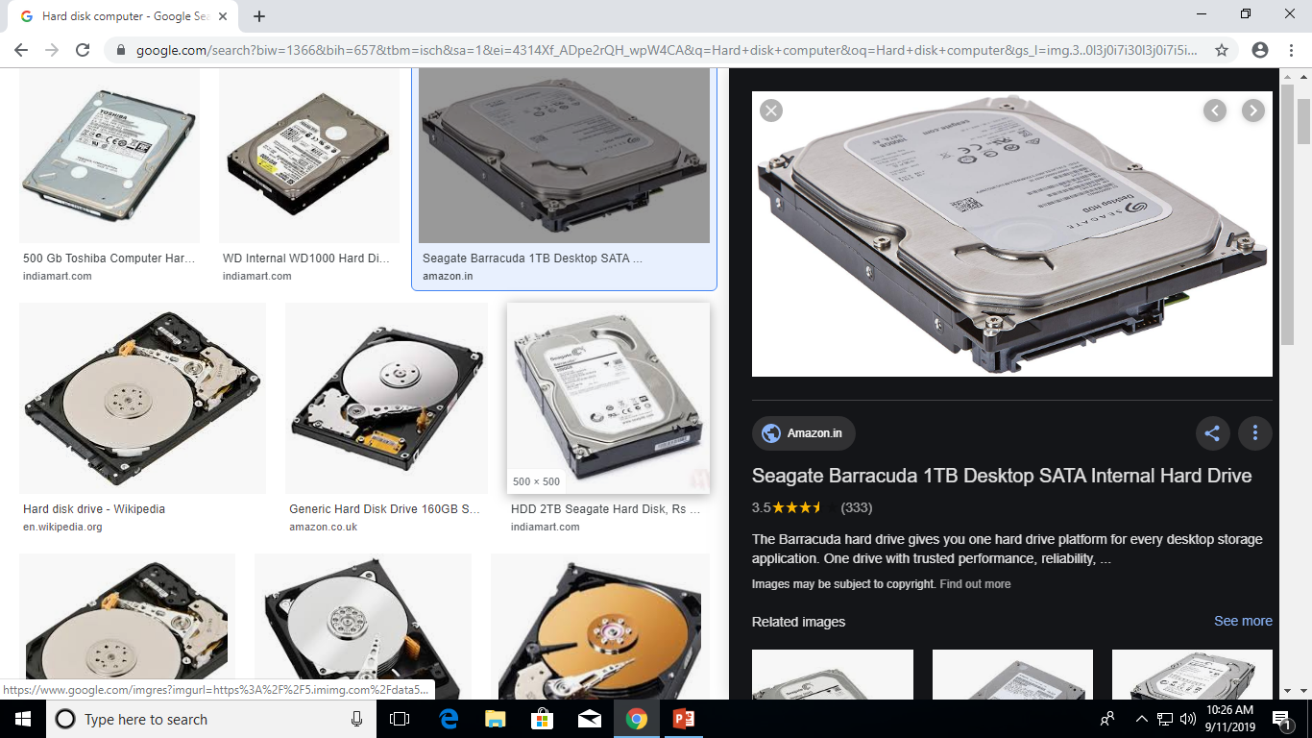
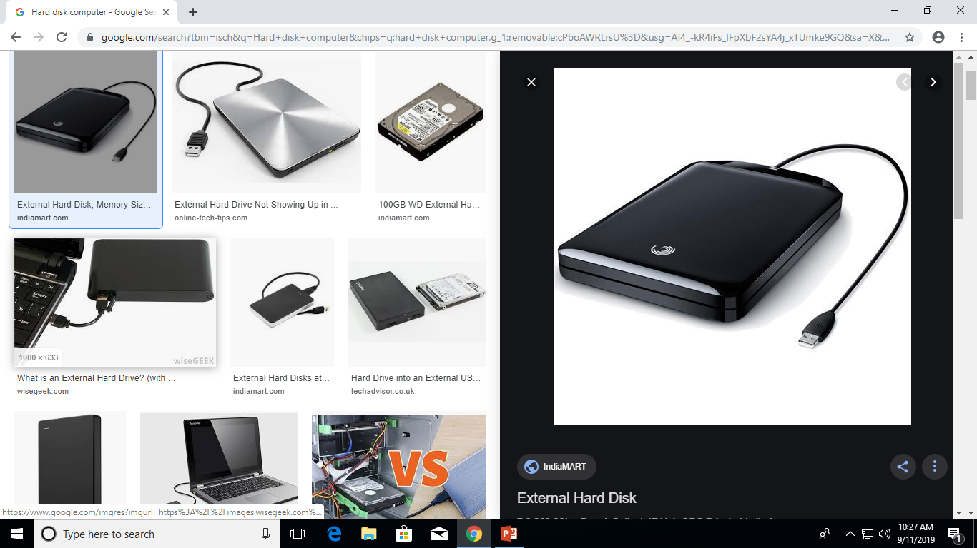

Slide 35
CONT’D
2. FLOPPY DISK:
The floppy disk is a removable magnetic storage medium.
Floppy disks are used for moving information between computers, laptops or other devices.
Some early digital cameras electronic music instruments and older computer game consoles use floppy disks.
Floppy disks are inserted in to a floppy disk drive or simply floppy drive to allow data to be read or stored.
Floppy disks store much less data than a CD-ROM disk or USB flash drive.

Slide 36
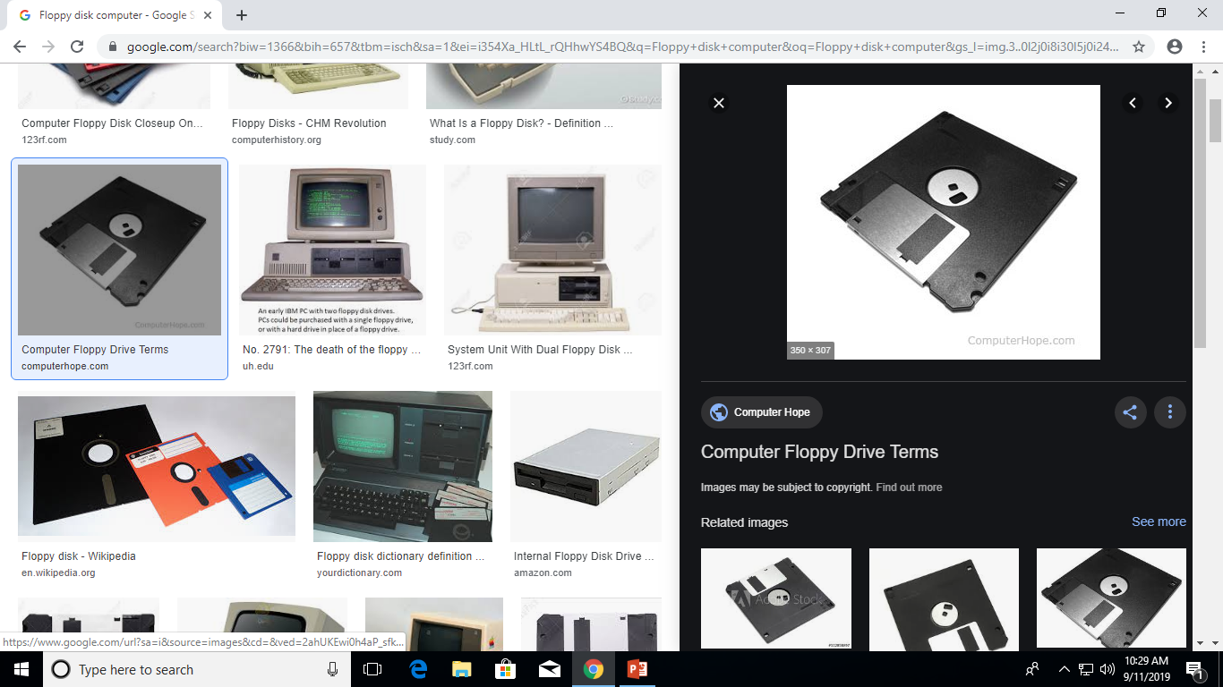

Slide 37
CONT’D
3. COMPACT DISK (CD):
Is a digital optical disc data storage format that was co-developed by Philips and Sony and released in 1982.
The first CD-ROMs could hold about 600 MB of data, but now they can hold up to 700 MB.
CD-ROMs share the same technology as audio CDs, but they are formatted differently, allowing them to store many types of data.

Slide 38
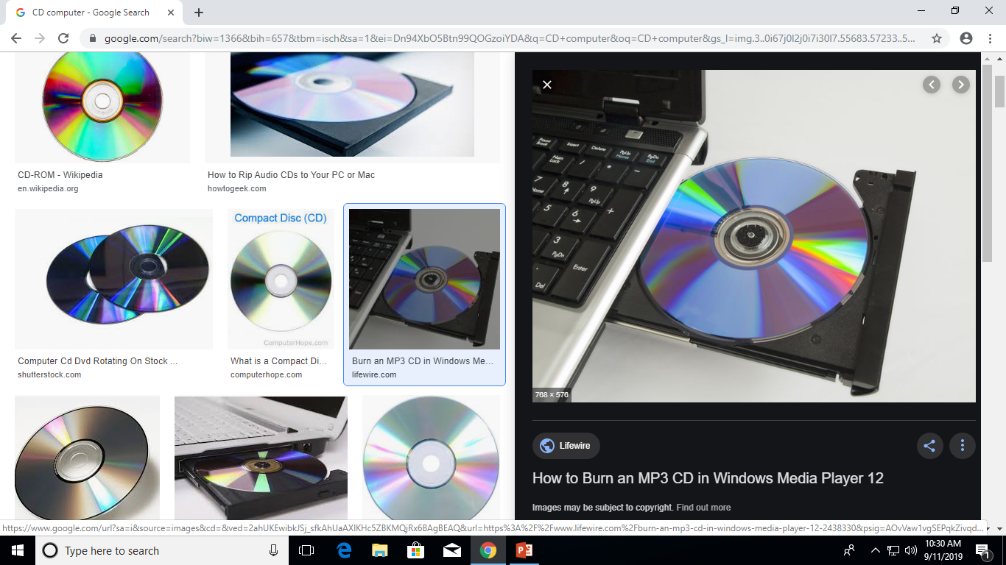

Slide 39
CONT’D
4. DVD (DIGITAL VERSATILE DISC):
Digital optical disc storage format invented and developed in 1995.
The medium can store any kind of digital data and is widely used for software and other computer files as well as video programs watched using DVD players.
DVDs offer higher storage capacity than compact discs while having the same dimensions

Slide 40
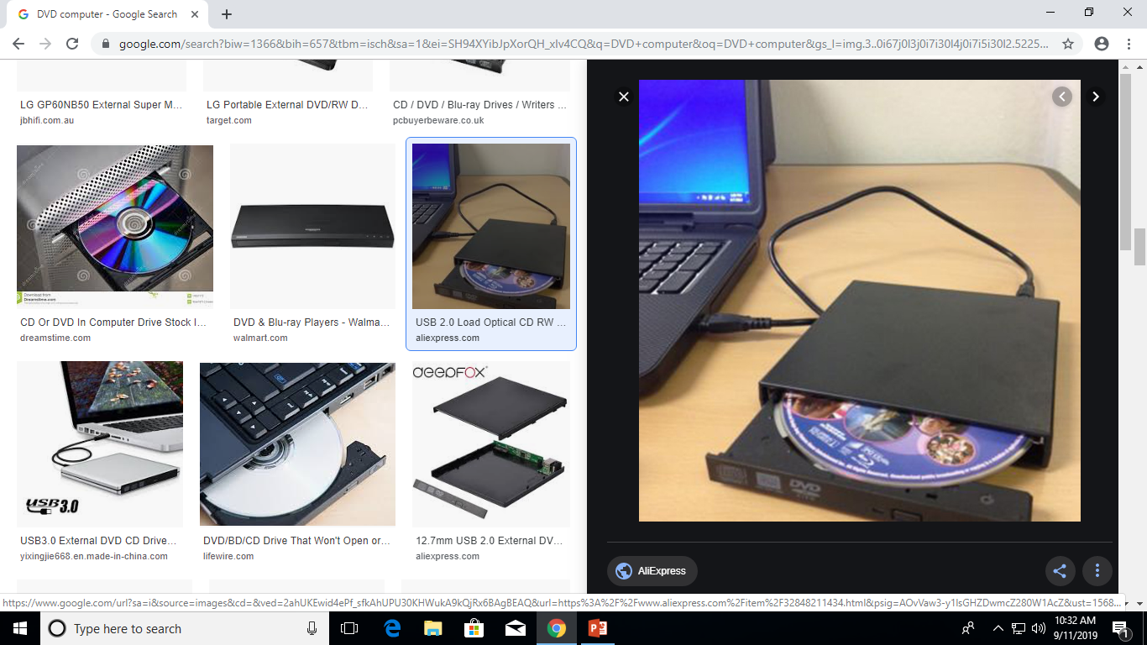

Slide 41
CONT’D
4. PEN DRIVE:
Small self powered drive that connects to computer digitally through USB port.
It enables you to read, write, delete and move from one source to another.
Stores data from 1 GB to 64 GB

Slide 42
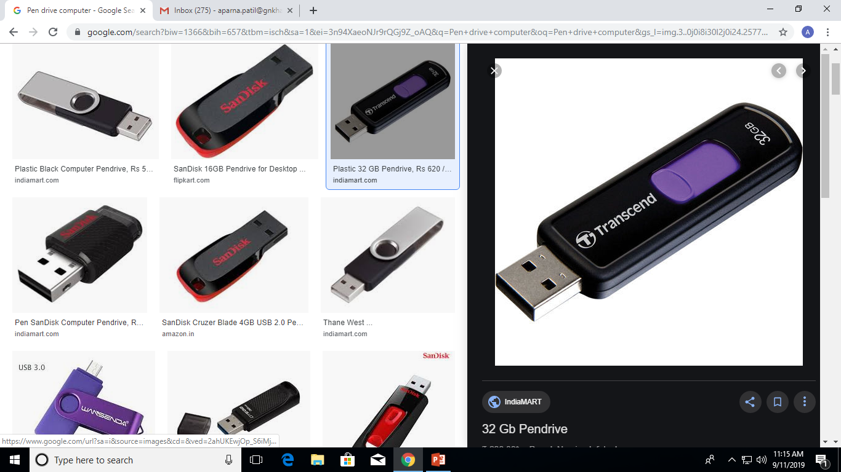

Slide 43
Revision:
Q. Types of memory
Q. List down storage devices
Q. What's the use computer
Q. Difference between SRAM and DRAM
Q. How the memory is measured?
Q. What are input devices and list down input devices?
Q. What are output devices and list down output devices?

Slide 44
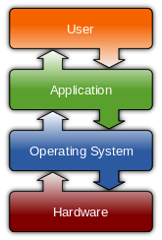
Software Component
1. Operating system
An operating system (OS) is system software that manages computer hardware and software resources and provides common services for computer programs E.g. Windows 10 ,Linux etc.

Slide 45
Software Component
2. Applications software
An application program is the type of program that you use once the operating system has been loaded.
Examples include word-processing programs, spreadsheets and databases

Slide 46
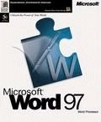
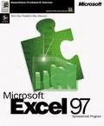
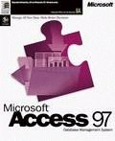
Software Component
Application Software
Word processing applications
Microsoft Word
Spreadsheets
Microsoft Excel
Database
Microsoft Access

Slide 47
Information Network
Uses of Network
If ten people are working together within an office it makes sense for them all to be connected.
In this way the office can have a single printer and all ten people can print to it.
In a similar way other devices such as modems or scanners can be shared.
Even more useful is the ability to share information when connected to a network.

Slide 48
Information Network
LAN
A LAN (Local Area Network) is a system whereby individual PCs are connected together within a company or organization
MAN – MAN or Metropolitan area Network covers a larger area than that of a LAN and smaller area as compared to WAN. It connects two or more computers that are apart but resides in the same or different cities.
WAN
A WAN (Wide Area Network) as the name implies allows you to connect to other computers over a wider area (i.e. the whole world).

Slide 49

Uses of Computer
PC at Home
Common uses for the computer within the home
Computer games
Working from Home
Banking from Home
Connecting to the Web

Slide 50

Uses of Computer
Computers in Daily Life
Accounts
Games
Educational
On-line banking
Smart ID cards
Supermarkets
Working from home (Tele-working)
Internet

Slide 51
Computer Threats
The term “threat” is defined as any kind of software potentially or directly capable of inflicting damage to a computer or network and compromising the user's information or rights (that is, vulnerabilities that can result in hacker attacks).

Slide 52
Types of Computer Threats
1. Computer Viruses
A computer virus is a program written to alter the way a computer operates, without the permission or knowledge of the user. A virus replicates and executes itself, usually doing damage to your computer in the process.
2. Computer Worms
Worms have become a lot more widespread than viruses and other types of computer threats recently. Like viruses, they are able to reproduce themselves and spread their copies, But don't require the activation of their host file.
3. Scareware
Scareware is the malware tricking the victim into buying the software by displaying the false virus alerts.

Slide 53
4. Keylogger
Keyloggers also called the keystroke logger, could easily track all real-time activity in the computer of the user. While using the computer, the Keyloggers would be running in the background as well as records everything making the user pass information to a hacker easily.

Slide 54
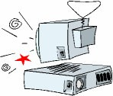
How To Improve Computer Security?
For safeguarding the system from cyber security attacks, it is much more important to have high advance software on the PC. Below are some of the steps you need to follow for improving your Computer Security System
Use best antivirus software with internet protection system
Never download untrusted email attachments
Do not download software from unreliable sites
Having a good network firewall security system is a good option

Slide 55
Operating Systems

Slide 56
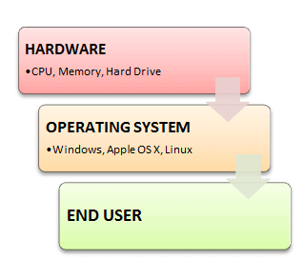
What is OS?
Operating System is a software, which makes a computer to actually work.
It is the software the enables all the application programs we use.
The OS organizes and controls the hardware.
OS acts as an interface between the application programs and the machine hardware.
Examples: Windows, Linux, Unix and Mac OS, etc.,

Slide 57
What OS does?/ OBJECTIVE???
An operating system performs basic tasks such as,
controlling and allocating memory,
prioritizing system requests,
controlling input and output devices,
facilitating networking and
managing file systems.

Slide 58
Structure of Operating System

Slide 59
Operating Systems functions:
The main functions of operating systems are:
Program creation
Program execution
Input/Output operations
Error detection
Resource allocation
Accounting
protection

Slide 60
HISTORY OF OS
Operating systems were first developed in the late 1950s to manage tape storage.
The General Motors Research Lab implemented the first OS in the early 1950s for their IBM 701
In the mid-1960s, operating systems started to use disks
In the late 1960s, the first version of the Unix OS was developed
The first OS built by Microsoft was DOS. It was built in 1981.
The present-day popular OS Windows first came to existence in1985 when a GUI was created and paired with MS-DOS.

Slide 61
ADVANTAGE OF OS
Allows you to hide details of hardware by creating an abstraction
Easy to use with a GUI
It provides the computer system resources with easy to use format
Acts as an intermediator between all hardware's and software's of the system

Slide 62
DISADVANTAGE OF OS
It is never entirely secure as a threat can occur at any time.
If any issue occurs in OS, you may lose all the contents which have been stored in your system
Operating system's software is quite expensive for small size organization which adds burden on them.
Example: Windows

Slide 63
Types of OS
Operating System can also be classified as,-
1. Single User Systems: WINDOWS
2. Multi User Systems: LINUX(Lovable Intellect Not Using XP), UNIX(UNiplexed Information Computing System)

Slide 64
INTRODUCTION TO WINDOWS
Windows OS, computer operating system (OS) developed by Microsoft Corporation to run personal computers (PCs).
The co-founder of Windows, Bill Gates, along with Paul Allen announced Microsoft Windows on November 10, 1983.
The first version of Windows, released on November 20, 1985, was simply a GUI offered as an extension of Microsoft's existing disk operating system, or MS-DOS.
Each version of Windows includes a graphical user interface, with a desktop that allows users to view files and folders in windows.
For the past two decades, Windows has been the most widely used operating system for personal computers PCs.
Designed to work on INTEL and AMD processor therefore installed on multiple brands of hardware, such as Dell, HP, and Sony computers, as well as home-built PCs.

Slide 65
MS-DOS
Windows 1.0 - 2.0
Windows 3.0 – 3.1
Windows 95
Windows 98
Windows ME - Millennium Edition
Windows NT 31. - 4.0
Windows 2000
Windows XP
Windows Vista
Windows 7
Windows 8
Windows 10
Windows Server
Windows Home Server
Windows CE
Windows Mobile
Windows Phone 7-10

Slide 66
FEATURES OF WINDOWS OS
Speed
Compatibility
Search and Organization
Safety and Security
Taskbar/Start menu

Slide 67
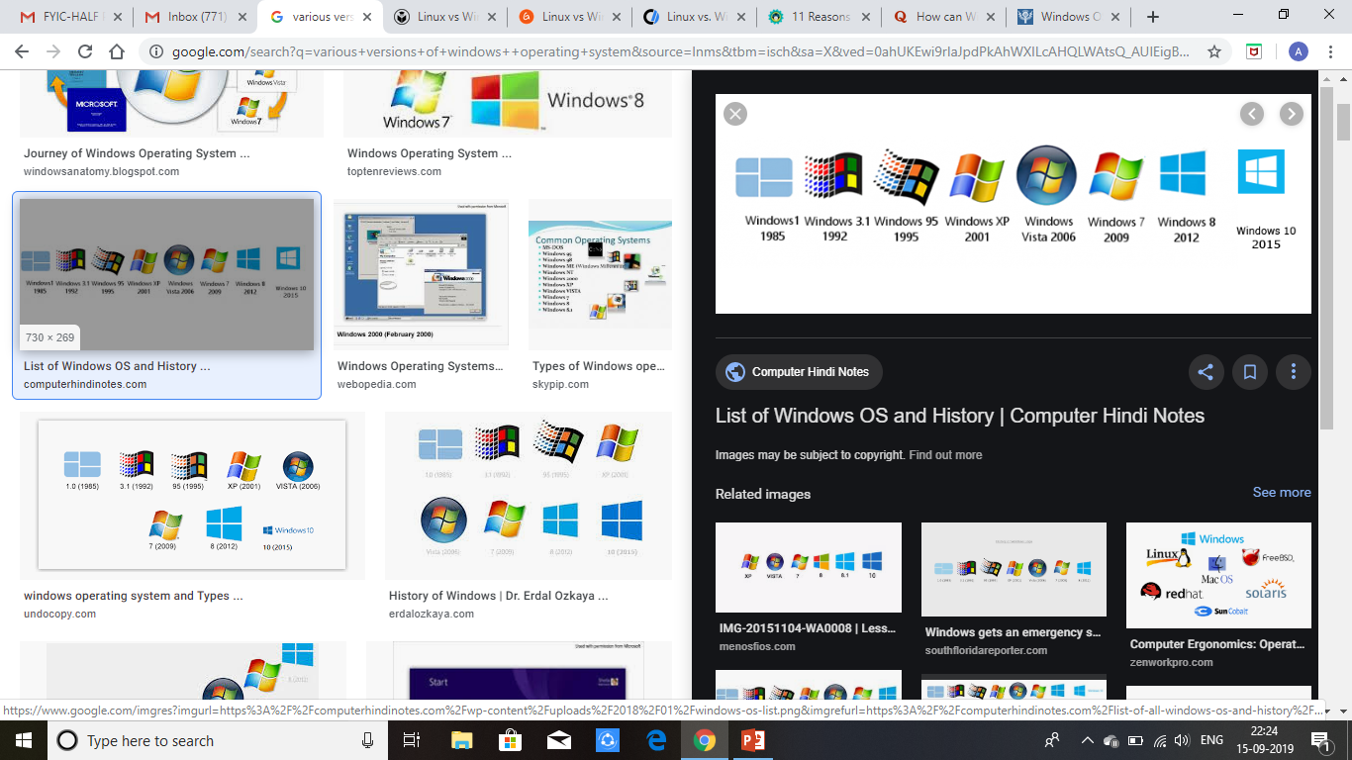
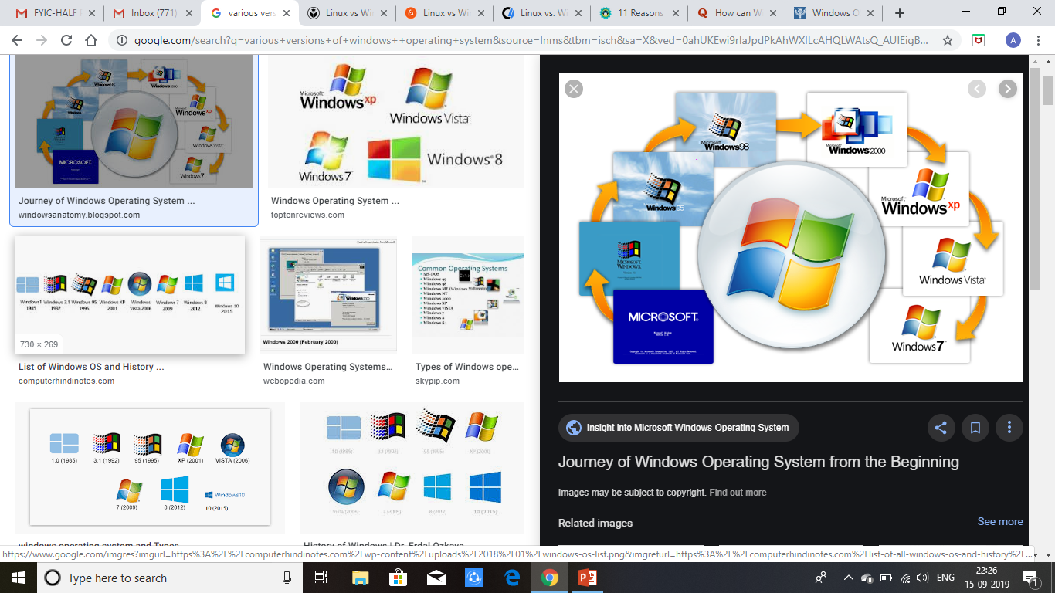

Slide 68
INTRODUCTION TO LINUX
Linux is an operating system or a kernel.
It is distributed under an open source license.
Its functionality list is quite like UNIX.
Linus Torvalds when he was a computer science student has developed this as an hobby
Application programs build on the operating system.
It forms the interface between the hardware and application programs as well as the interface between the hardware and people (users).

Slide 69
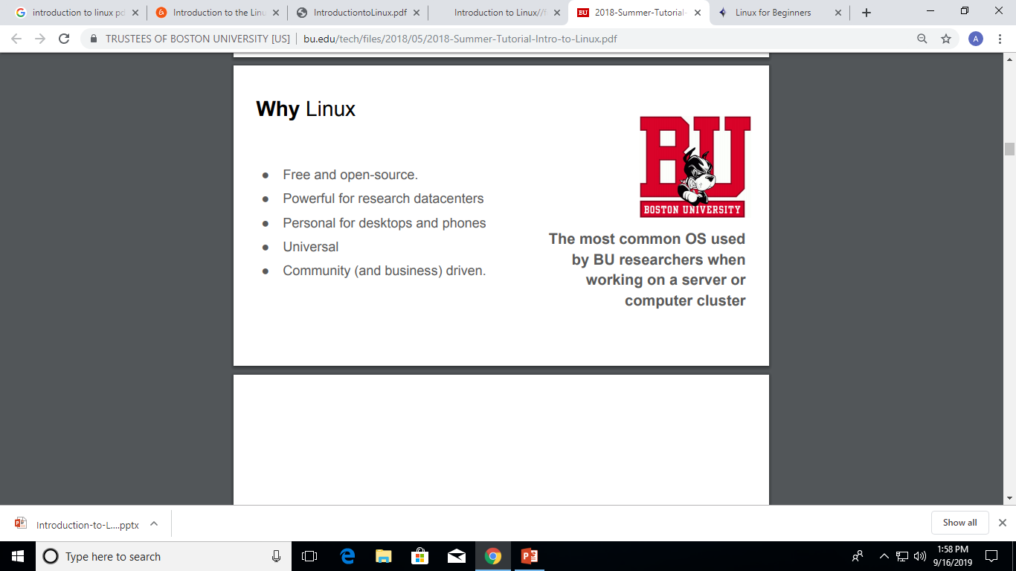

Slide 70
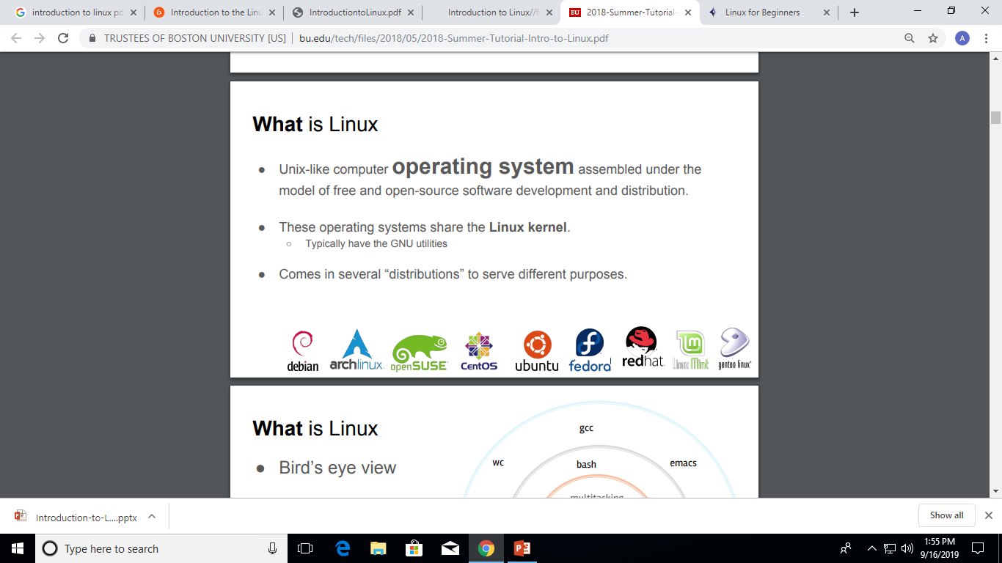
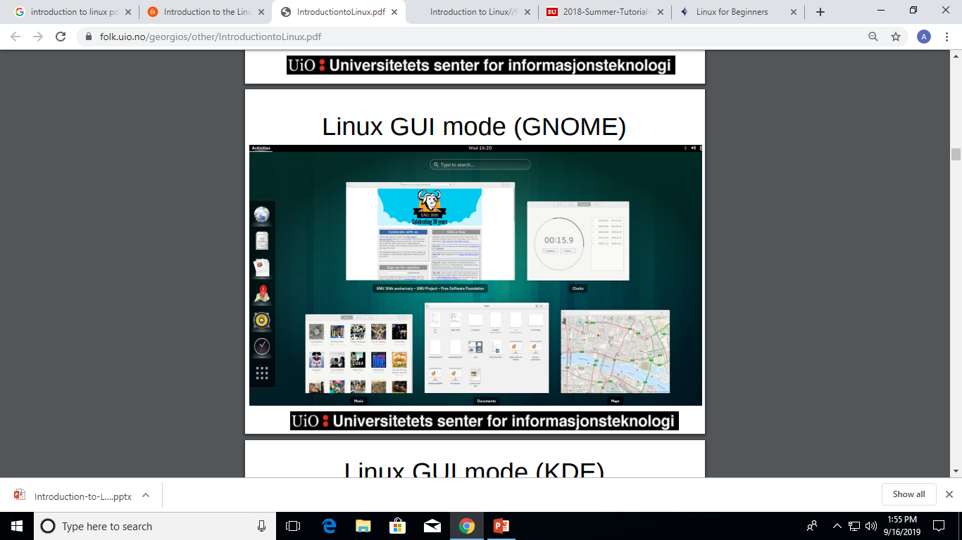

Slide 71
FEATURES OF LINUX OS
Portable – Portability means softwares can works on different types of hardwares in same way. Linux kernel and application programs supports their installation on any kind of hardware platform.
Open Source – Linux source code is freely available and it is community based development project. Multiple teams works in collaboration to enhance the capability of Linux operating system and it is continuously evolving.
Multi-User – Linux is a multiuser system means multiple users can access system resources like memory/ ram/ application programs at same time.
Multiprogramming – Linux is a multiprogramming system means multiple applications can run at same time.
Security – Linux provides user security using authentication features like password protection/ controlled access to specific files/ encryption of data.

Slide 72
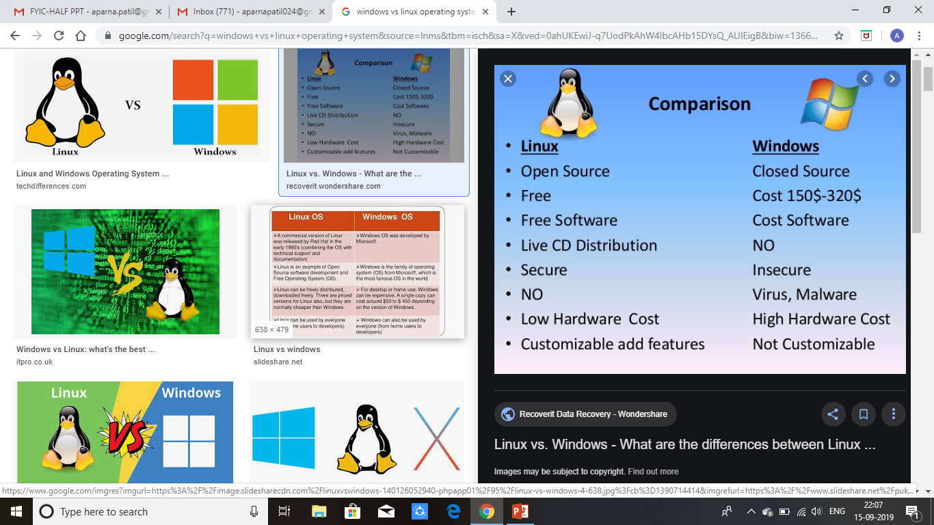

Slide 73
VIVA QUESTIONS:
What is an operating system?
What is the main purpose of an operating system?
How Can I Avoid Computer Viruses?
How Can I Protect My Home Computer?
Types of network
Disadvantage of network

Slide 74
THANK YOU

